Slide 1
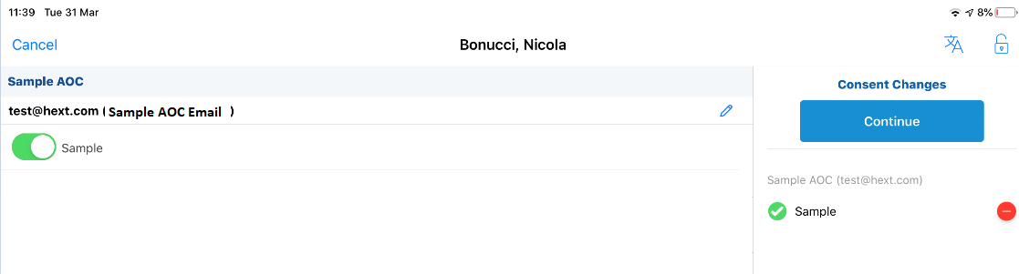
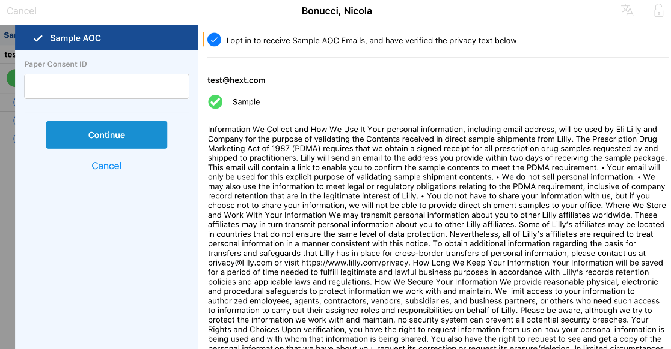
Sample AOC Design Proposal
Capturing the Email – Consent Capture Page
1
1
Sales rep changes from ‘consent’ screen to ‘Sample AOC’ screen using this toggle
2
2
Sales rep adds email address and moves the toggle
3
3
HCP verifies privacy text
4
Sales Rep Clicks Continue
4

Slide 2
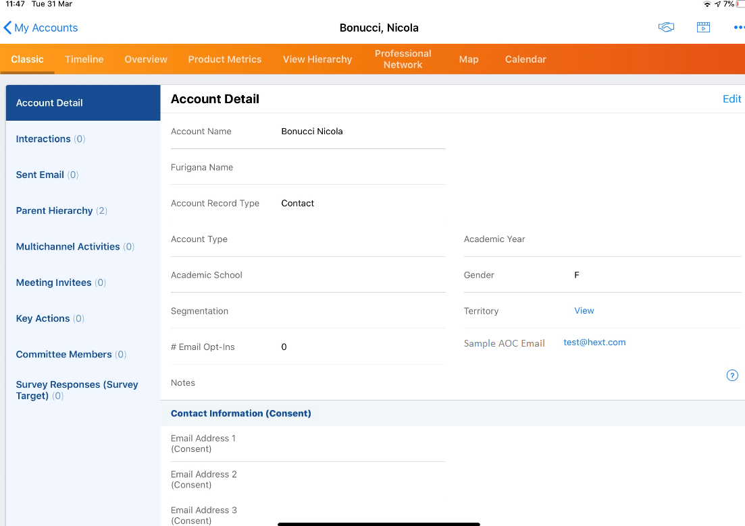
Sample AOC Design Proposal
Capturing the Email – Consent Capture Page
5
Email is then stored on the account page, and we have a ‘Multichannel Consent’ record to verify that the customer viewed privacy notice.
5

Slide 3
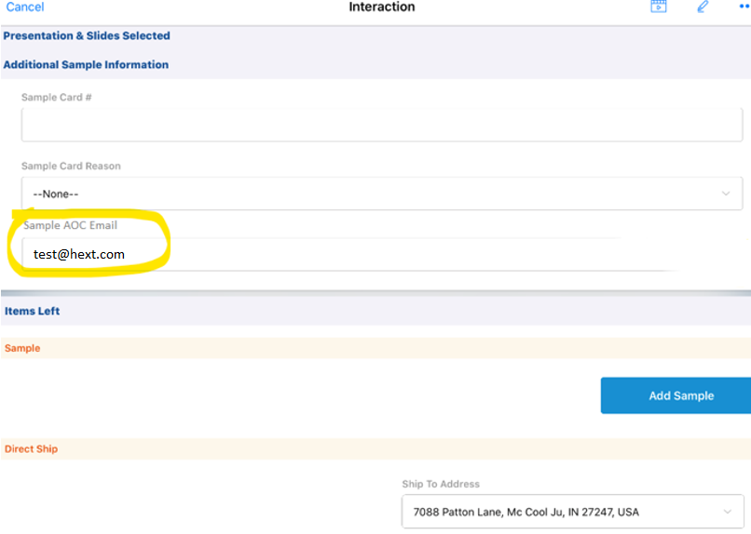
Sample AOC Design Proposal
Capturing the interaction
1
Interaction is completed/signed for as per usual process
Rep can see the sample AOC email on the interaction page, when sending a sample. This is pre-populated from account page, and is read only.
If a rep needs to change the email address, they must exit the interaction and change it on the account level.
2
2
3

Slide 4
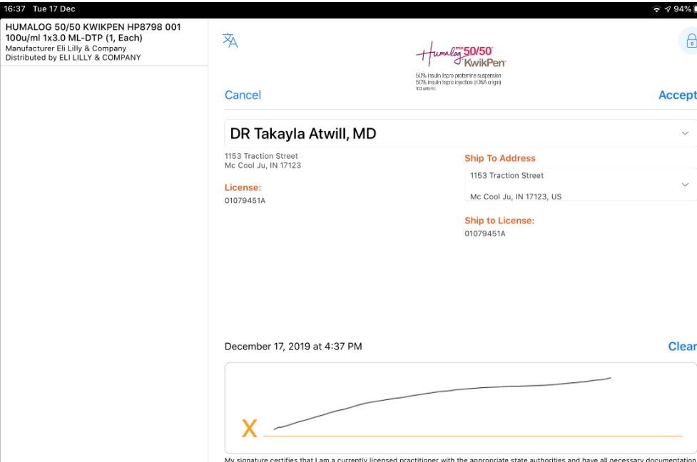

Sample AOC Design Proposal
Sending the email value to SAP
1
Rep completes the sample transaction
Sample AOC Email Address is stamped from the account/call record onto the sample transaction (DTP) record
DTP record (inc. Sample AOC Email) is sent to SAP
2
3

Slide 5
Technical Changes Required? TBC Pending Veeva Review
Account
Create a new email field on account page for ‘Sample AOC Email’.
Consent Set Up
Create a new Consent Header, Consent Type, Consent Line, Content Type for the new consent set up, using the new account field as the ‘channel source’.
Update outbound message to GCCP to restrict these Sample MCC records from being sent to GCCP.
Interaction
Create ‘pull-in’ field on interaction page for ‘Sample AOC Email’ from Account Page
Sample Transaction
Create new ‘Sample AOC Email’ field on sample transaction object
Stamp every sample transaction record with ‘Sample AOC Email’ value from account page
Interface
Include ‘Sample AOC Email’ field on sample transaction object in the outbound DTP interface with SAP.

